Slide 1

Semantic Kernel Hackathon

Slide 2
Agenda
Welcome ______________________________________________________ 2-5 minutes
Introductions ________________________________________________ 5-10 minutes
Semantic Kernel overview __________________________________ 20-30 minutes
Challenges 1-5 ___________________________________________ 360+ minutes
Design thinking(Optional) _________________________________ _ 100-120 minutes
Responsible AI ______________________________________________ 15-20 minutes
Hack! ________________________________________________________ 360+ minutes

Slide 3


Welcome
Hackathons are a great platform for innovation, skill development, relationship building, and problem solving. Semantic Kernel runs hackathons across the world and have seen incredibly impressive results.
+
=
Semantic Kernel
You
Innovation

Slide 4
Introductions
✋ We’ll start by inviting one person to volunteer to go first.
👉 After introducing themselves, they’ll select the next person to speak.
🔁 Continue this process until everyone has gone.

Slide 5

Let’s talk about AI
Check out the resources here to learn about the latest on AI at Microsoft.
You dream it. AI helps build it. Microsoft is empowering the world to achieve more with AI and its copilot ecosystem.

Slide 6
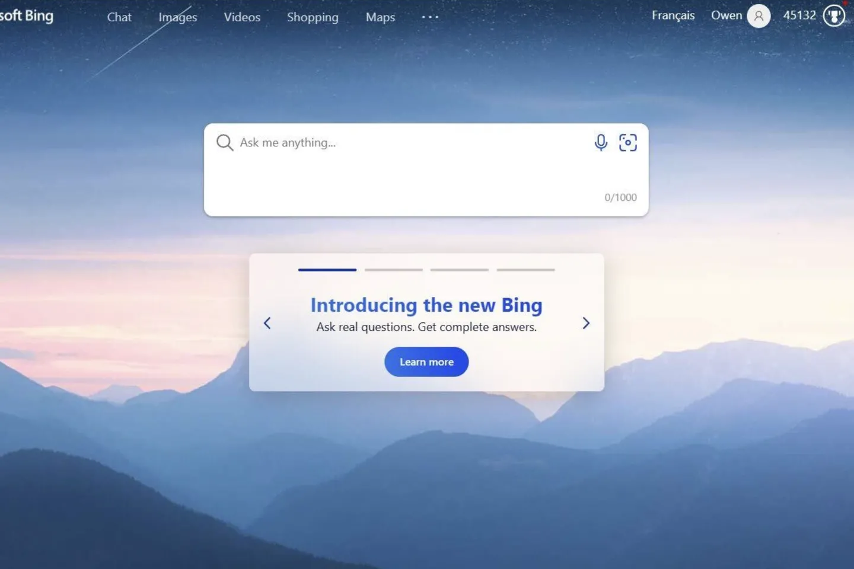
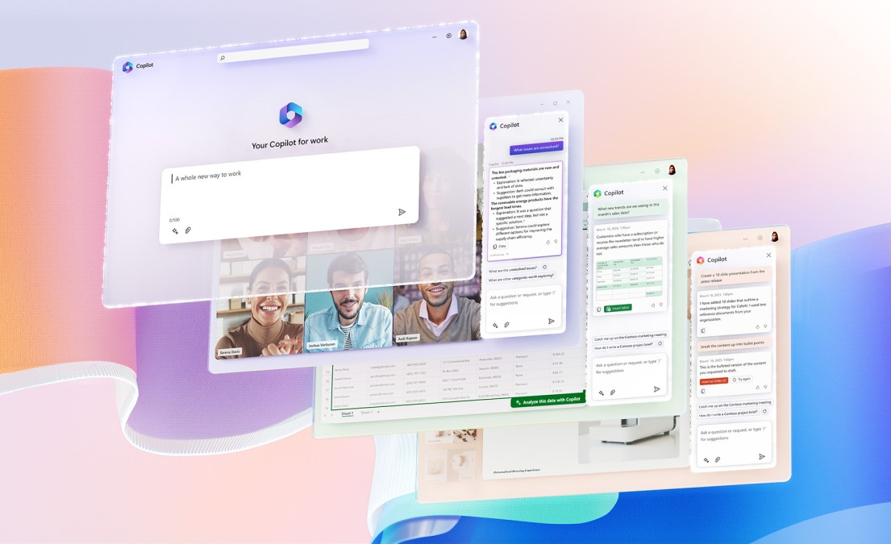
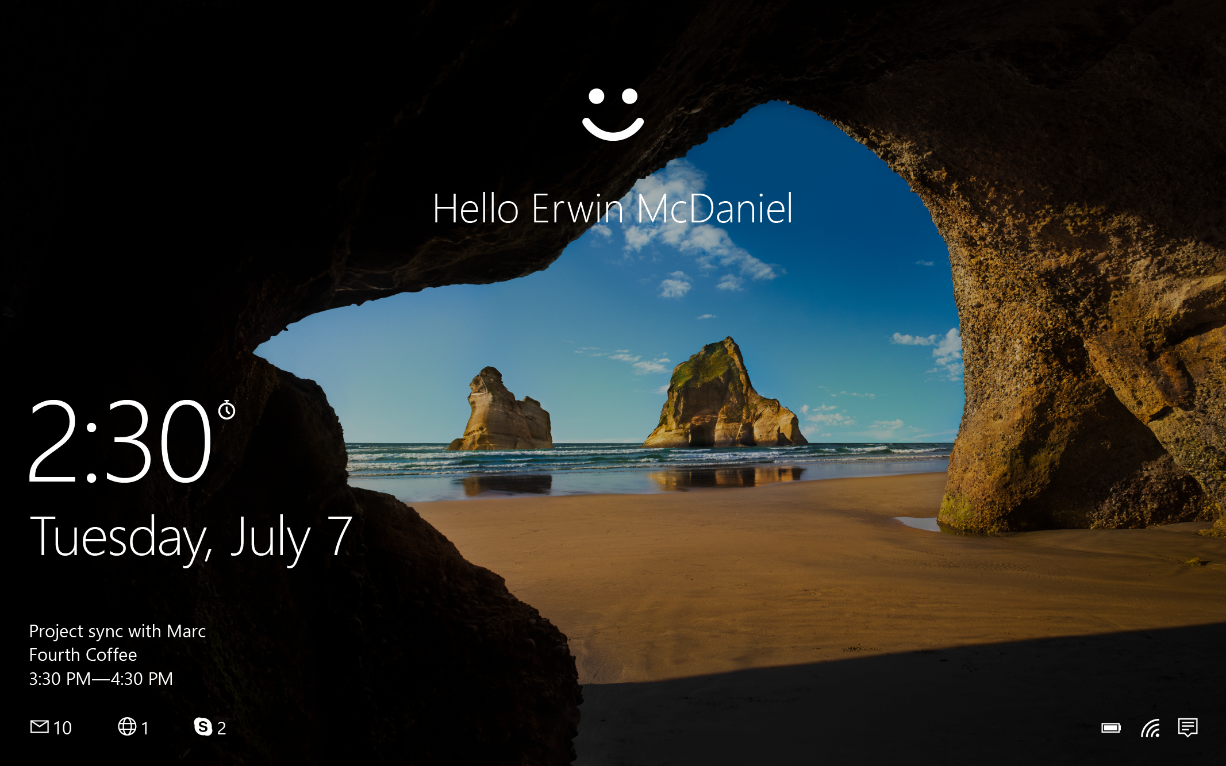
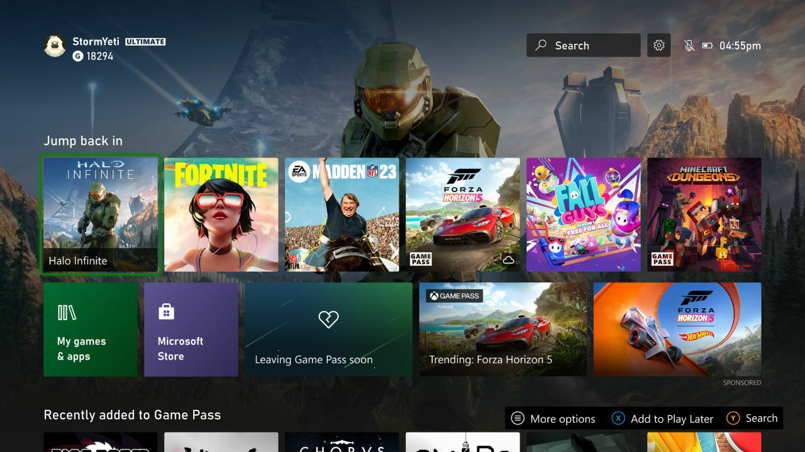
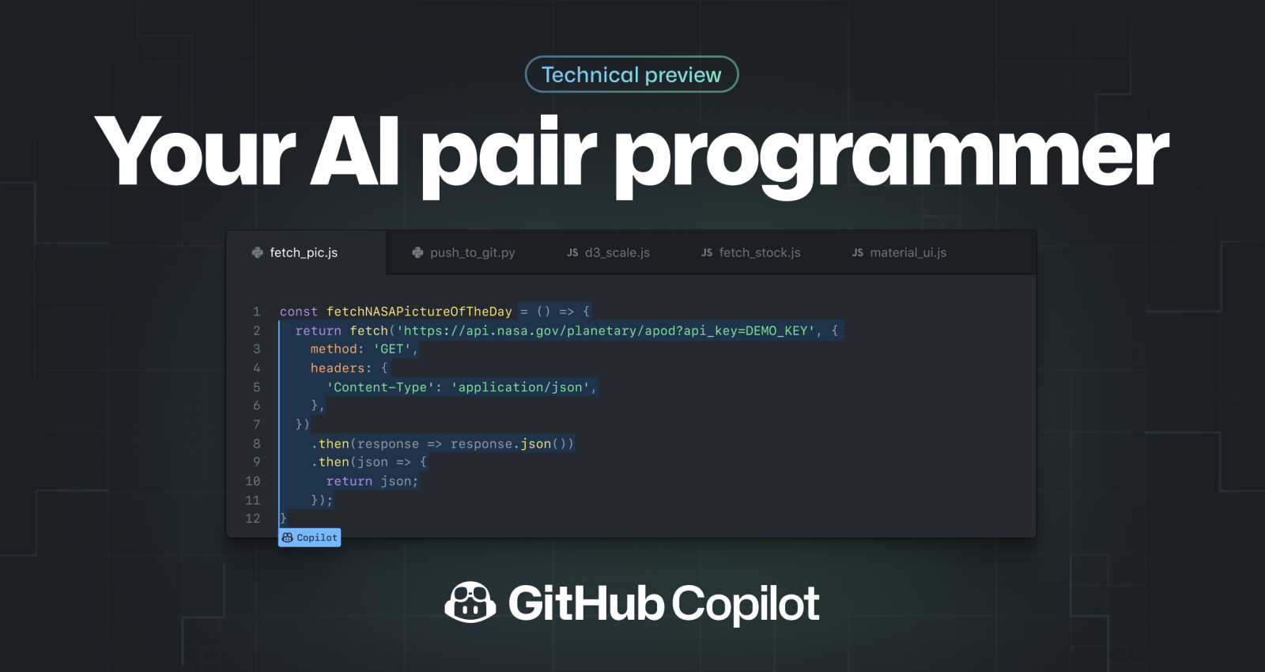





Modernized & augmented flagship products with copilot
AI-based search with Microsoft Copilot
Copilot for Work across Office 365
Biometric identity verification
Personalized recommendations
Copilot assisted coding

Slide 7


Apps
Plugin extensibility
At the center of it all is Semantic Kernel
Copilots
AI orchestration
Foundation models
AI infrastructure
S E M A N T I C K E R N E L / Microsoft confidential

Slide 8



What is Semantic Kernel?
An open-source SDK that lets you easily build agents that call your existing code. As a highly extensible framework, it can be used with models from OpenAI, Azure OpenAI, Hugging Face, and more!
By combining your existing C#, Python, and Java code with these models, you can build agents that answer questions and automate processes.
Python
Java
.Net

Slide 9

A bridge between LLMs and your code
Your models
Your code
ML RESEARCHER
APP DEVELOPER
keeping up with advances
stable and performant
cutting edge models
efficient to deliver
algorithm analysis
easily scalable
experimentation
maintainable
Your memories
Your prompts

Slide 10
Plugins &
These are the core building blocks of Semantic Kernel. By customizing these key components, you can create solutions to suite exactly your needs.
Planners &
Personas

Slide 11









Plugins
Plugins encapsulate capabilities into a single unit of functionality. When you build a plugin for Semantic Kernel, you can leverage it on other services, like ChatGTP, Bing, and Microsoft 365. Likewise, any plugin built for those services can seamlessly import to Semantic Kernel.
Plugins
Other AI apps
Semantic Kernel
Your app

Slide 12







Semantic or native?
To make a plugin, you'll need to create some functions. These are either semantic or native – you decide.
Time plugin
Semantic functions
Semantic functions
Endpoint
Semantic Kernel

Slide 13



Planners
Person has a request
A Planner is a function that takes the initial request and returns a list of steps needed to fulfill the request. AI is used to mix-and-match plugins registered in the kernel so it can recombine them into a series of steps.
Semantic Kernel
Plugins
Plan

Slide 14


Handlebars or stepwise?
To make plans, you'll need to define which planner to use. Choose between handlebars or stepwise planner.
Planner
Handlebars
Stepwise

Slide 15




Personas
Project manager agent
Personas are what defines an agent's role, like a set of instructions. They hold their own memories which provide broader context to the requests made.
This is what empowers multi-agent systems where specialists are defined to execute requests they were designed to fulfil.
Researcher agent
Copywriter agent
Designer agent

Slide 16
Managing personas
Agent orchestrator plugin
Through plugins, planners orchestrate agents. Choosing the best agent for the request.
Project manager agent
Researcher agent
Copywriter agent
Designer agent

Slide 17
Memories
This is what provides context to the initial request. Memories are fed into Semantic Kernel in a few different ways.
Conventional key-value pairs: Just like you would set an environment variable in your shell, the same can be done when using Semantic Kernel. The lookup is "conventional" because it's a one-to-one match between a key and your query.
Conventional local-storage: When you save information to a file, it can be retrieved with its filename. When you have a lot of information to store in a key-value pair, you're best off keeping it on disk.
Semantic memory search: You can also represent text information as a long vector of numbers, known as "embeddings." This lets you execute a "semantic" search that compares meaning-to-meaning with your query.

Slide 18
Prompts
This is how you communicate with model. It serves as the input which elicits a response from the model. Selecting the right words, phrases, symbols, and formats that guide the model in generating high-quality and relevant results.

Slide 19
Tutorials
Want some extra guidance? Check out these detailed walk throughs here

Slide 20
Questions?
Raise your hand or place your question in the chat.

Slide 21



Want to learn more?
Browse the Github repo & community board
Join the Discord community
Follow the dev blogs
https://aka.ms/sk/discord
https://aka.ms/sk/blog
https://aka.ms/sk/repo

Slide 22
Time to Hack !
https://github.com/microsoft/ai-developer

Slide 23
Design thinking
To facilitate creative problem solving let's use the Stanford D-School "Design thinking" methodology. Learn more
Empathize
Ideate
Define
Prototype
Test

Slide 24
Empathize
Empathize
Think about people. Interview coworkers and or customers about the work they do.
What processes do they use today?
Are there any existing points of friction?
What might make their experience better?​
If you had a magic wand to help them, what would happen?

Slide 25
Define
Define
Reflect on what you learned from Empathize and apply it here. Synthesize your learnings into a few needs.
What insights did you learn that you could leverage in your design?
Define the problem statement.

Slide 26
Ideate
Ideate
Sketch or write out 3 to 5 radical ways to meet the need you identified from the Define section.
Go for quantity over quality, this is the time to generate ideas, not refine (that'll happen later).
Share your ideas and capture feedback.
Iterate based on feedback.
Reflect and iterate.

Slide 27
Prototype
Prototype
Get a proof of concept going, something tangible that you can share and test.
Take the solution you landed on from the Ideate section and start building.
Share your prototype for feedback

Slide 28
Test
Test
After you have something ready, start testing it.
Get your prototype in front of the people that need this solution.
Capture their feedback and if needed, go back and edit your prototype to make it even better.

Slide 29
Break
Take 5 to 10 mins for a break.

Slide 30
Welcome back!
DAY 2 AGENDA
Welcome back ________________________________________________ 2-5 minutes
What did you learn?_________________________________________ 15-20 minutes
Hack! __________________________________________________________ 120 minutes
Demo _______________________________________________________ 60-80 minutes
Thank you _____________________________________________________ 2-5 minutes
Feedback ______________________________________________________ 2-5 minutes

Slide 31
Responsible AI principles
Fairness – AI systems treat all people fairly.
Reliability & safety – AI systems should perform reliably and safely.
Privacy & security – AI systems should be secure and respect privacy.
Inclusiveness – AI systems should empower everyone and engage people.
Transparency – AI systems should be understandable.
Accountable – People should be accountable for AI systems.

Slide 32
What did you learn?
Let's take some time to talk about how things went.
What did you learn?
What went well?
What could have been better?

Slide 33
Demos
✋ We’ll start by inviting one person to volunteer to go first.
👉 After demoing, they’ll select the next person to demo.
🔁 Continue this process until everyone has gone.

Slide 34
Thank you!
We love seeing the creative ideas that emerge from this process. It’s fun and impactful because of you, so THANK YOU!

